Slide 1

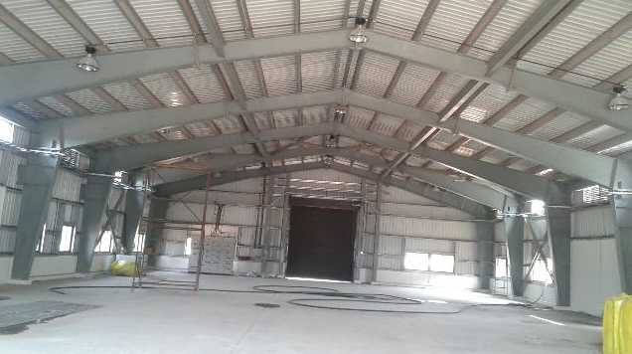
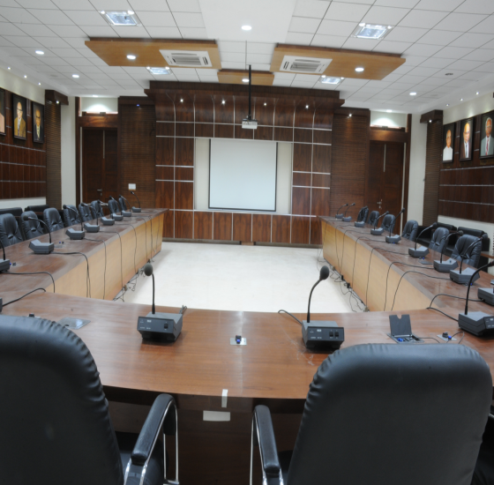
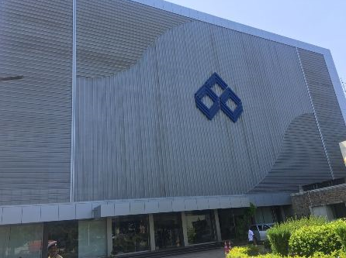
CREATORS ENGINEERS & INTERIORS Pvt.Ltd.
No. 7, Lakshmi Gardens,3rd Floor,4th Street,
Rangarajapuram,Srinagar colony,Saidapet,
Chennai – 600015.
PEB STRUCTURES
INTERIORS
CIVIL

Slide 2
INTRODUCTION – M/S CEIPL
We are one of the growing construction company involved in
different civil engineering field like PEB structures, Interior
decoration & furnishing works, Civil works etc on composite basis.
Execution team having 20+years experience in the respective field
and we have completed major projects for Airports Authority of
India, Chennai trade Center(CPWD) at nandambakkam, chennai
And BARC - Vishakapatnam, IGCAR – Kalpakkam, Indian institute
of Technology (IITM) and for various banking institution, educational
Institions, Commercial projects etc.,
At present we are working for Airports Authority of india, Indian
Institute of Technology Madras, Central public work department,
Indian Bank,BHEL,Central Warehouse corporation, HVF factory etc.,

Slide 3
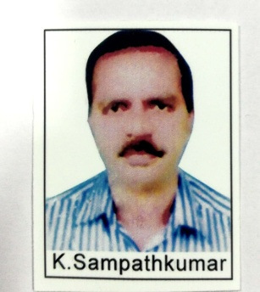
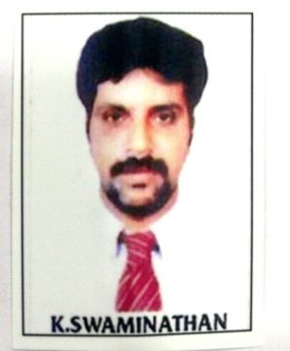
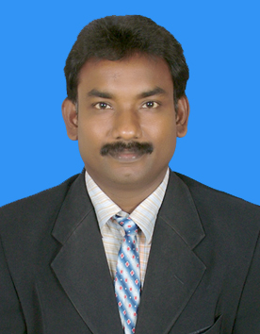
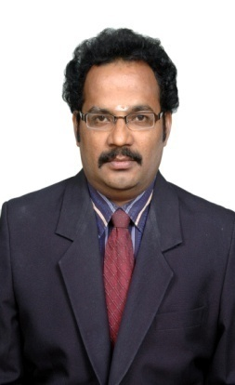
OUR MANAGEMENT TEAM
Er.K.Sampathkumar
M.Tech.,
Managing Director
Dr.K.Swamination.M.Tech
FIV.,MBA.,
Director
Er.S.Jambulingam
B.Tech
Director
Dr.S.Sakthivel,B.E.,A.M.I.E,
F.I.V.,
Director

Slide 4
OUR VISION
CREATORS vision is to be the leading construction company in our chosen markets, sought after by potential clients and employees for our track record in reliable execution, cost effectiveness, and world class technical sophistication with high standards.
Strategy We are committed to differentiate ourselves by continuously increasing our expertise in executing large, sophisticated buildings and infrastructure projects while maintaining a highly selective risk management process for all projects and venture.
Creators will always operate at highest level of safety, quality and cost effectiveness. To ensure, we remain the most attractive to our clients, employees and partners.
Our success comes from people, who strive to continuously innovate, adapt to local markets, and hone their skills.
Through this strategy, Creators will continue to grow and increase profitability.

Slide 5
OUR CORE VALUES
Excellence: We strive for excellence in quality, and we continuously innovate, utilizing advanced technologies
Teamwork: We insist on mutual respect, cooperation and mutual encouragement to achieve each individual’s potential
Integrity: We act with reliability, honesty and fairness
Commitment: We are fully dedicated to deliver our objectives through the most efficient use of resources
Sustainability: We are committed to safeguard all stakeholders, including especially the health and safety of our employees, society as a whole and the environment
Accountability: We are fully accountable for carrying out our responsibilities in accordance to the values and principles of CREATORS

Slide 6
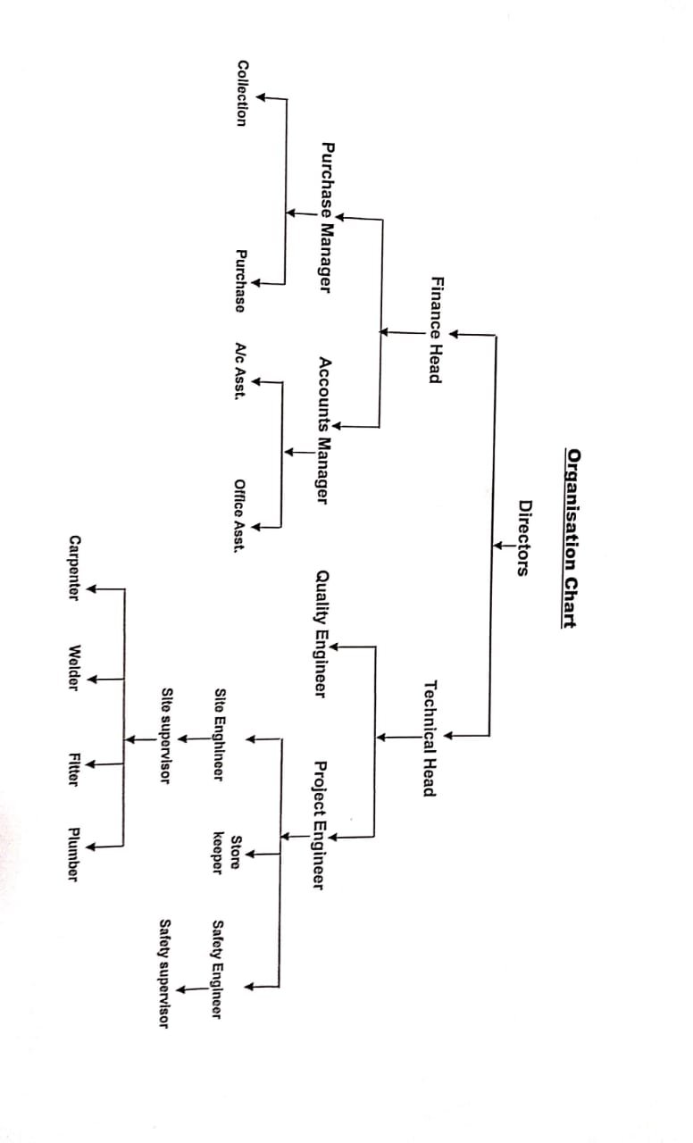
ORGANISATION FLOW CHART

Slide 7
BUSINESS EXPANSION
We have Our Business establishment in Trichy (head office) and
In chennai (Branch office).
We have upgraded in quality management system in accordance with
ISO 9001 :2015 for scope of Design, Fabrication, Erection and
Commisioning of Pre Engineering Building Structures,
Construction of Buildings and Providing Interior Services.
We are Enlisted Contractors for PWD contractors Class I ,Central
public work department (CPWD) Class I upto 50 Crore &
Empanelment of agencies for Construction of Pre-Engineered / Pre-
Fabricated Buildings at Airports – Category III – More than Rs.5.00
Cr.
We are Enlisted for DRDO Civil Category upto Rs.500.00 Lakhs
and NSIC, empanelled contractors for Indian Bank, IOB, SBI,RBI,
UCO,IITM,etc.,

Slide 8
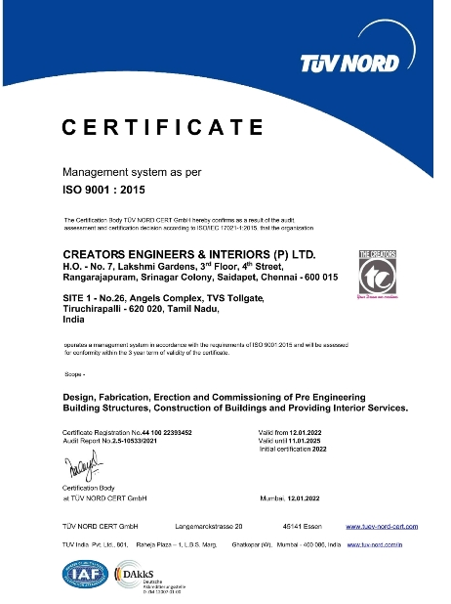
ISO REGISTRATION CERTIFICATE

Slide 9
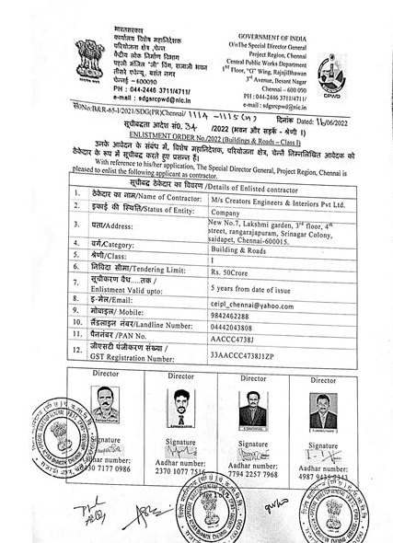
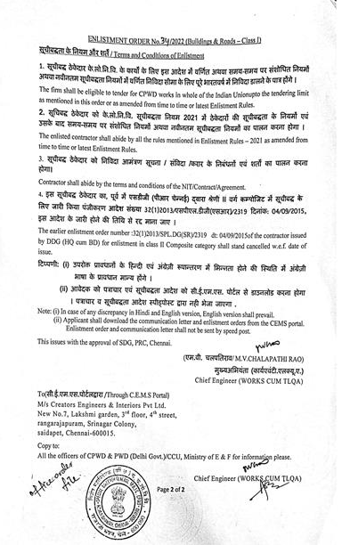
CPWD REGISTRATION CERTIFICATE

Slide 10
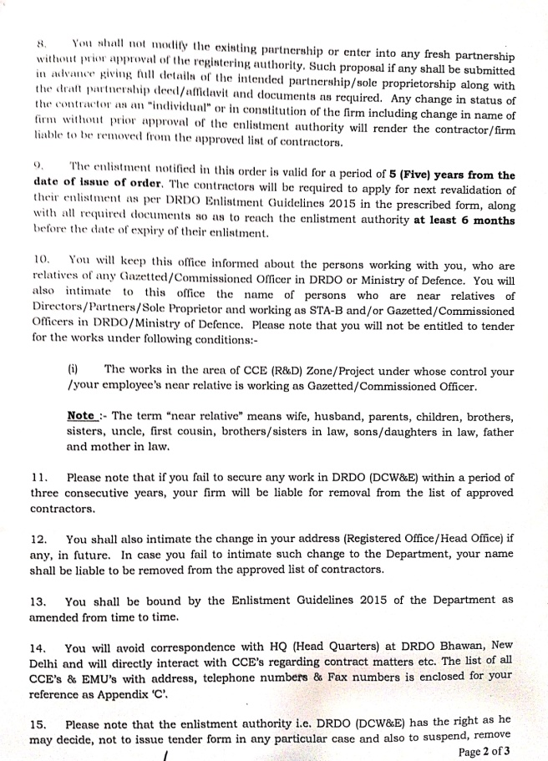
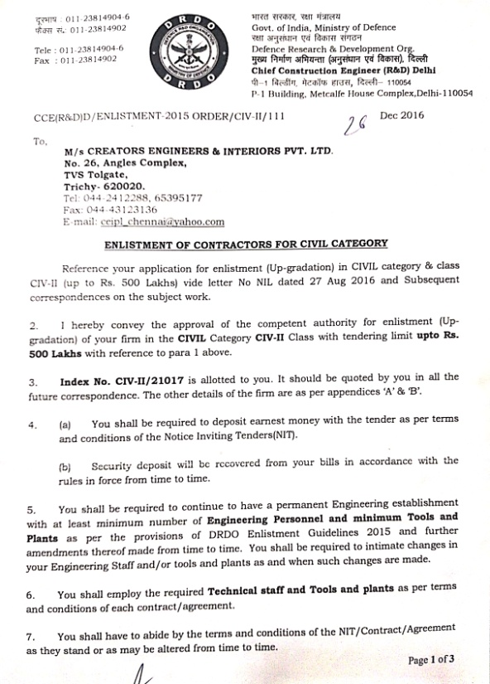
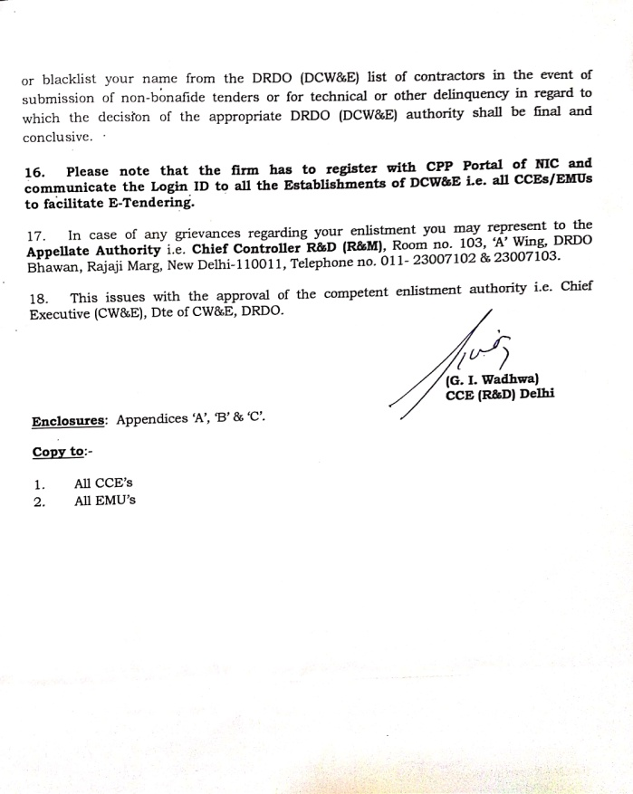
DRDO REGISTRATION CERTIFICATE

Slide 11
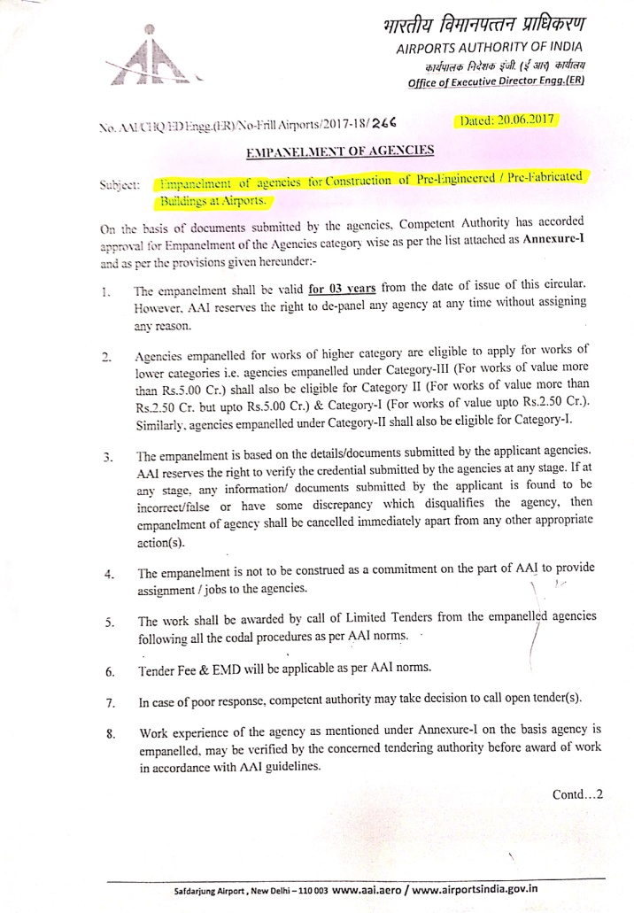
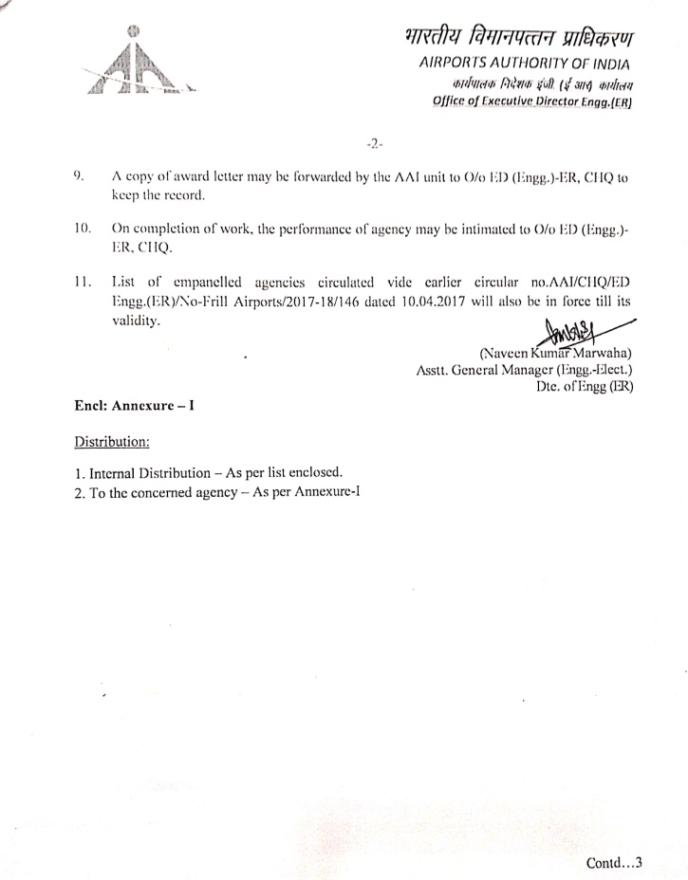
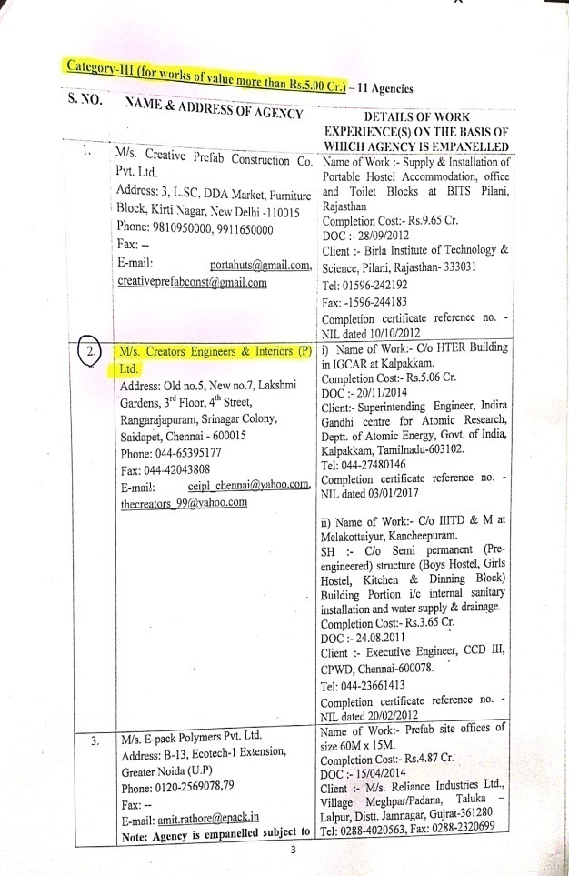
AAI REGISTRATION CERTIFICATE

Slide 12
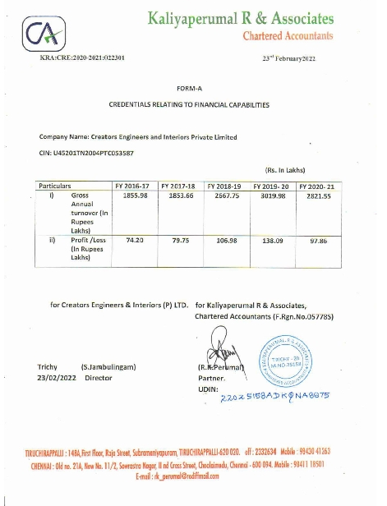
Auditor Turnover Details

Slide 13
CREATORS ENGINEERS AND INTERIORS PVT LTD
PEB Structures – A few Projects
IGCAR - HTER Building work at Kalpakkam (Nov’14)
BARC - PEB work at Vishakapatnam ( Jan’2017)
TFS - PEB work at AAI chennai (Oct’2018)
AAI - PEB work at AAI hangar (Aug’2008)
AAI - PEB work at AAI Cargo (Jun’2018)
AAI - Structural work at AAI chennai
A. Canopy on airside & city Side (Mar’2017)
B. Structural Cradle System (May’2018)
AAI - Structural paint work at AAI chennai(Mar’18)
CPWD - Structural work at Chennai Trade centre Hall No
III (Nov’2007)

Slide 14
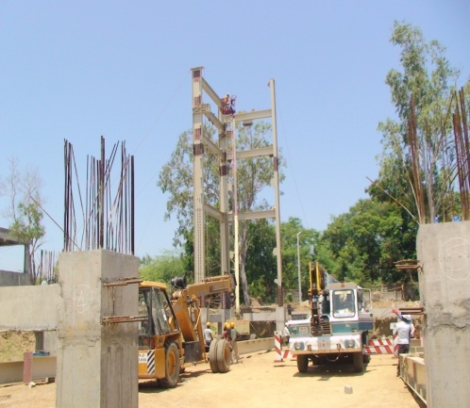
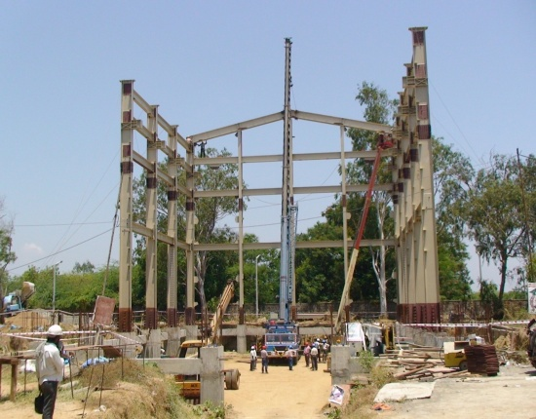
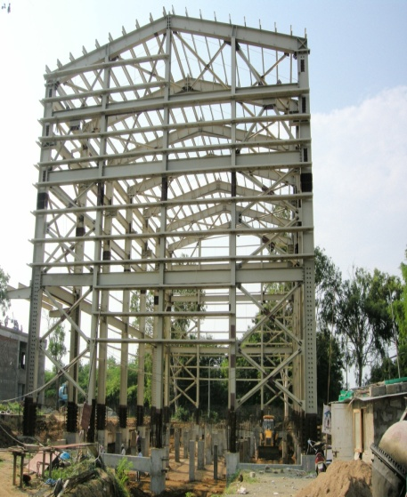
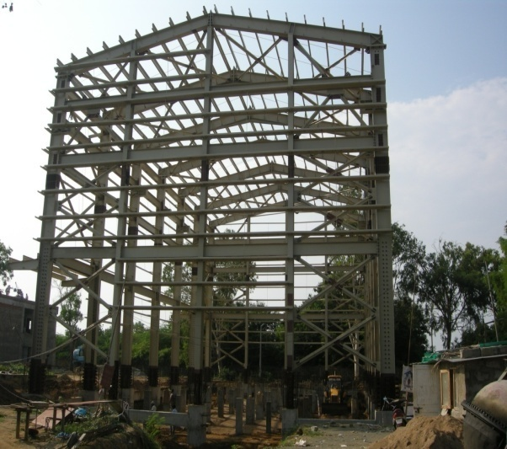
IGCAR – HTER Building work at Kalpakkam
The height of the
Building 23 Mtrs ,
50mm thk sandwitch
Panel for roofing and
Wallpanels
Including foundation
And civil works
Total value of Project
Rs.506.00L(Enhansed
Value 7% per annum
Rs. 759.36L)

Slide 15
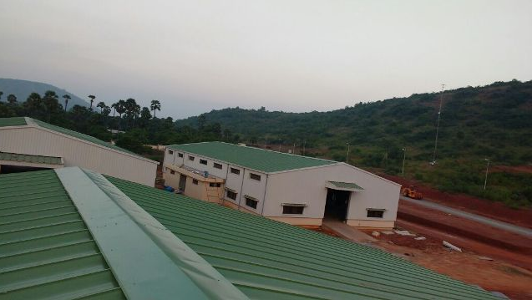
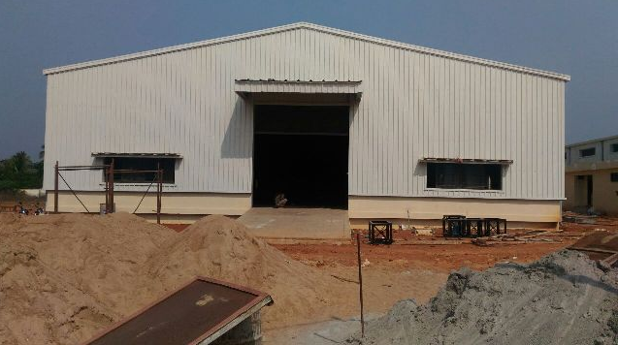
BARC – PEB WORK AT VISHAKAPATNAM
Design and executed of PEB including
standing seam roofing sheet Total Area of 2500 sqm
(App.) – to a value of Rs.404.54L

Slide 16
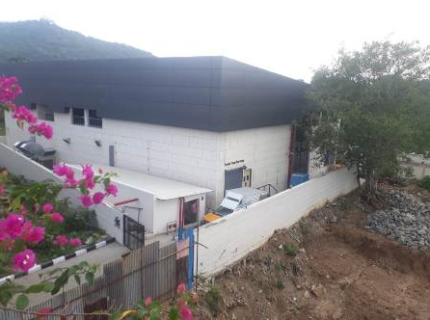
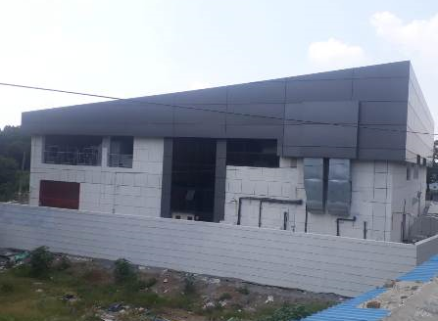
TFS – PEB WORK AT AAI CHENNAI AIRPORT
The cloud kitchen design and executed for TFS
To a total area of 3000 sqm (App.) – total value -550 Lakhs
Steel building with decking sheet along with exterior
Finishes with mezzanine floor.

Slide 17
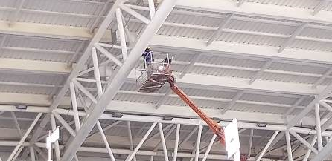
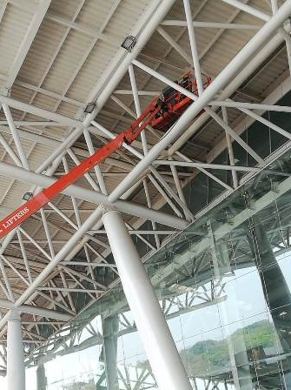
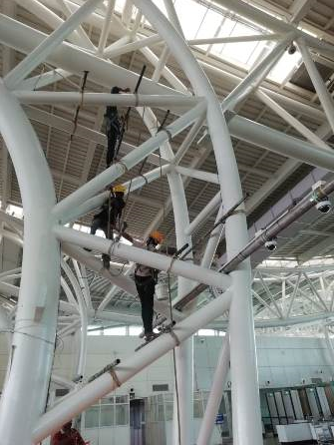
AAI – Structural painting work at Chennai
Structural painting
To a max. height of
30 Mtrs.
To the terminal
Building of chennai
airport Chennai in the
Restricted working
condition With
advanced boom lift
To a value of Project
Rs.484.25L

Slide 18
CREATORS ENGINEERS AND INTERIORS PVT LTD
INTERIORS & CIVIL – A few Projects
Extension of Existing bus lounge / SHA at T-1 (Civil
works)
Interiors – Partition work at BSNL Greams Road
(CPWD Project)
Refurbishment and Interior design to NPTEL and CCE
Project
Facelifting work at IOB Main building central office

Slide 19
Infrastructure work at AAI Chennai Airport Projects
Interiors works at Hindustan University , Padur
SINGARA MAHAL, Kalyana mahal work at KATTUR, TRICHY
SS GRAND MAHAL, Work at KADAYANALLUR, THENKASI
EMERALD PALACE, SAMAYAPURAM, TRICHY
VANI MAHAL work at ARIYALUR
COMMERCIAL SHOPPING COMPLEX @ KATTUR, TRICHY

Slide 20
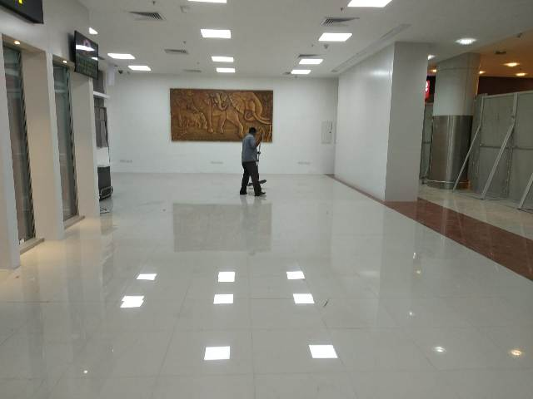
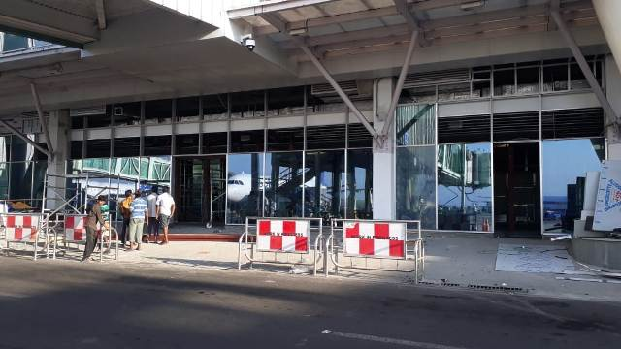
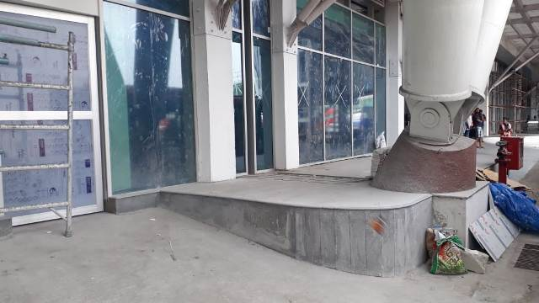
Extension of Existing bus lounge / SHA at T-1
(Civil works)
Buslounge was constructed under restricted area and restricted
time to a project value of Rs.178.36L – Area of 1200 sqm(app)
Including double glazing, ACP Cladding, Tileing & Falseceiling
Work, partition works

Slide 21
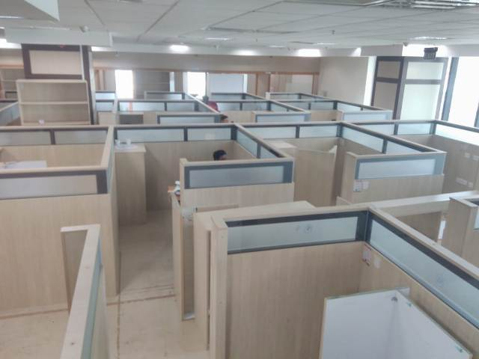
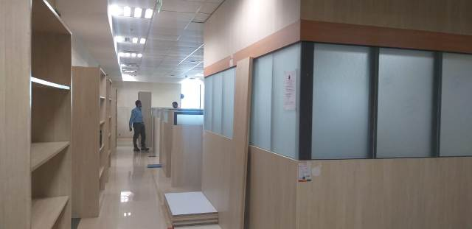
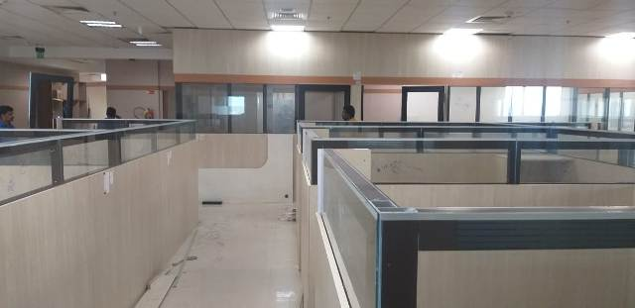
Interiors – Partition work at BSNL Greams Road (CPWD Project)
Double skin partition work at 5th & 8th floor work at Greams
Road to a Project value of Rs. 110.00 Lakhs

Slide 22
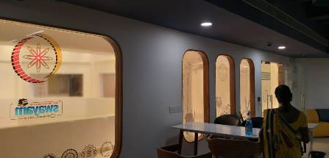
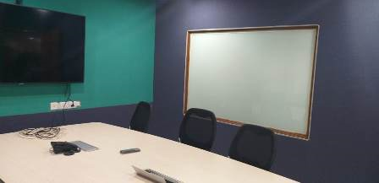
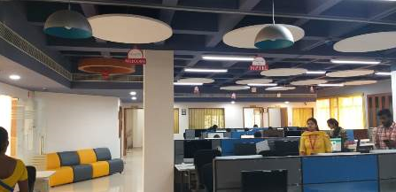
Refurbishment and Interior design to NPTEL and CCE Project
Acoustic Arrangement for Studio at ICSR, IIT Madras to a
project value of Rs. 150.00 L

Slide 23
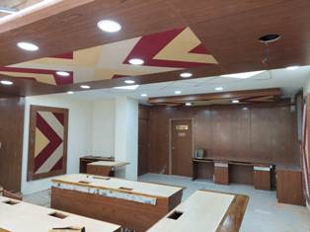
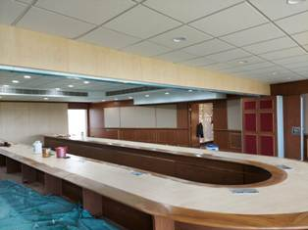
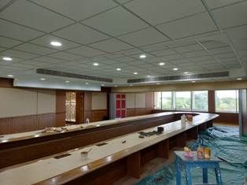
IITM – SENATE HALL INTERIOR PROJECTS
INTERIOR FURNISHINGS WORK AT IIT ADMIN BLOCK – value of work 2 Cr

Slide 24
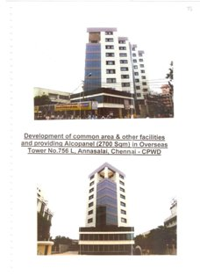
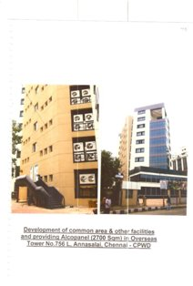
OVERSEAS TOWER WORK AT MOUNT ROAD CHENNAI

Slide 25
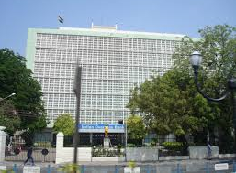
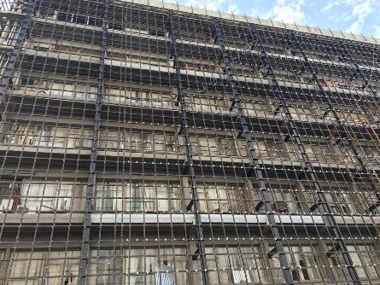
Facelifting work at IOB Main building central office
Facelift work for IOB, Central office at prime location with
Kalzip, ACP cladding including Structural design & Execution
to a project value of Rs. 339.80L

Slide 26
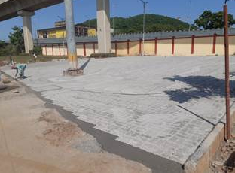
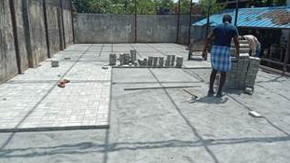
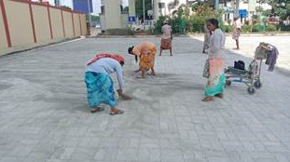
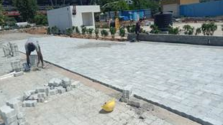
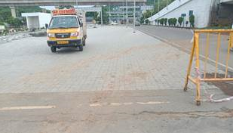
Infrastructure work at AAI CHENNAI AIRPORT PROJECTS

Slide 27



Infrastructure work at AAI CHENNAI AIRPORT PROJECTS

Slide 28





Interior work at Hindustan University

Slide 29



Interior work at Hindustan University

Slide 30



Interior work at Hindustan University

Slide 31




SINGARA MAHAL, Kalyana Mandapam work at KATTUR, TRICHY

Slide 32




SS GRAND MAHAL, Work at KADAYANALLUR, THENKASI

Slide 33




EMERALD PALACE, SAMAYAPURAM, TRICHY

Slide 34



VANI MAHAL work at ARIYALUR

Slide 35



COMMERCIAL SHOPPING COMPLEX @ KATTUR, TRICHY.

Slide 36


Shop /Factory Details – Avadi
Factory / Shop Image

Slide 37
THANK YOU

